Slide 1
Relational Algebra
courtesy of Joe Hellerstein for some slides
Jianlin Feng
School of Software
SUN YAT-SEN UNIVERSITY

Slide 2
Formal Relational Query Languages
Relational Algebra: More operational, very useful for representing execution plans.
Relational Calculus: Describe what you want, rather than how to compute it. (Non-procedural, declarative.)
Understanding Algebra & Calculus is key to
understanding SQL, query processing!

Slide 3
Preliminaries
A query is applied to relation instances
The result of a query is also a relation instance.
  Schemas of input relations for a query are fixed
  Schema for the result of a query is also fixed.
    determined by the query language constructs
Positional vs. named-field notation:
  Positional notation easier for formal definitions
  Named-field notation more readable.
  Both used in SQL
    Though positional notation is discouraged

Slide 4
Relational Algebra: 5 Basic Operations
Selection ( σ )
  Selects a subset of rows (horizontal)
Projection ( π )
  Retains only desired columns (vertical)
Cross-product ( × )
  Allows us to combine two relations.
Set-difference ( — )
  Tuples in r1, but not in r2.
Union ( ∪ )
  Tuples in r1 or in r2.
Since each operation returns a relation, operations can be composed! (Algebra is “closed”.)

Slide 5
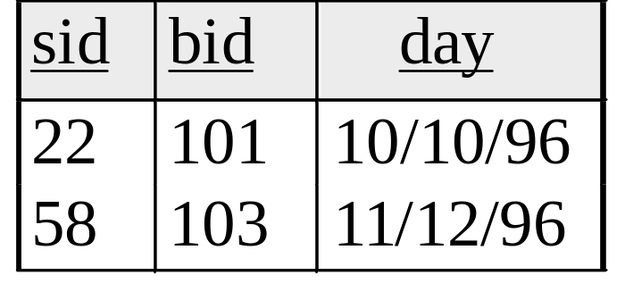
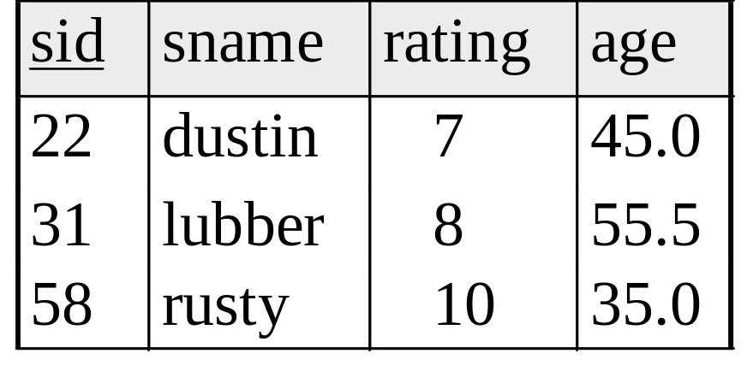
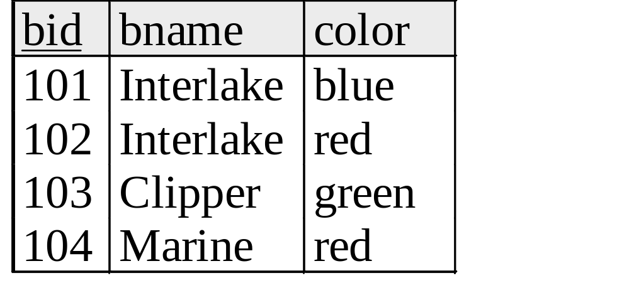
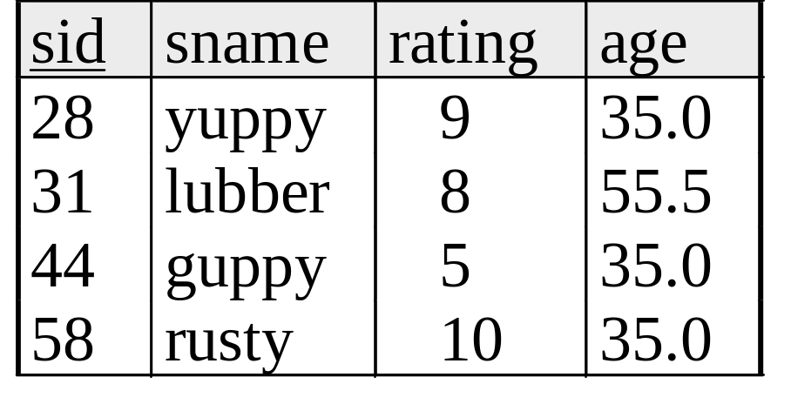
Example Instances
R1
S1
Boats
S2

Slide 6
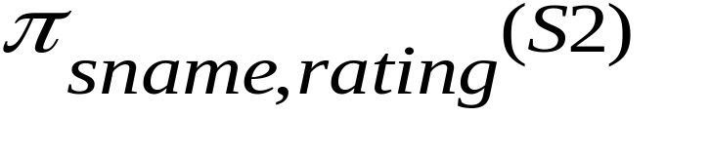
Projection (π)
Example:
Retains only attributes that are in the “projection list”.
Schema of result:
  the fields in the projection list
  with the same names that they had in the input relation.
Projection operator has to eliminate duplicates
  Note: real systems typically don’t do duplicate elimination
  Unless the user explicitly asks for it.
  (Why not?)

Slide 7
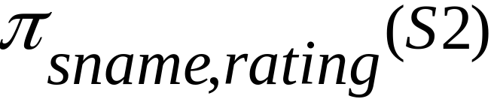
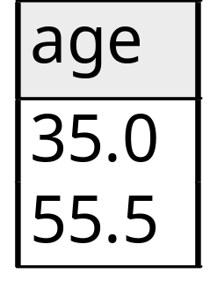
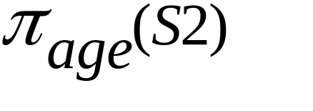
Projection (π)
sname
rating
yuppy
9
lubber
8
guppy
5
rusty
10
S2

Slide 8
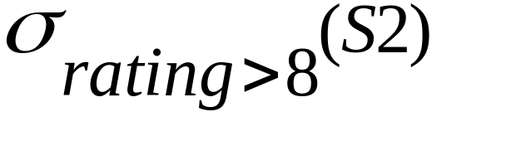
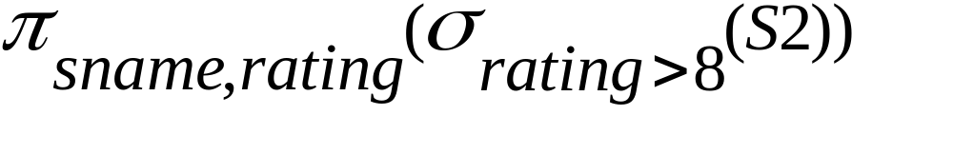
Selection (σ)
Selects rows that satisfy selection condition.
Result is a relation.
  Schema of result is same as that of the input relation.
Do we need to do duplicate elimination?
sid
sname
rating
age
28
yuppy
9
35.0
sname
rating
31
lubber
8
55.5
yuppy
9
44
guppy
5
35.0
58
rusty
10
35.0
rusty
10

Slide 9
Union and Set-Difference
Both of these operations take two input relations, which must be union-compatible:
  Same number of fields.
  ‘Corresponding’ fields have the same type.
For which, if any, is duplicate elimination required?

Slide 10
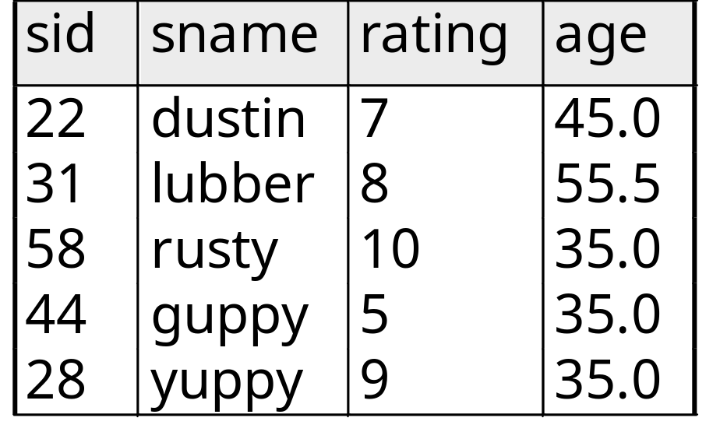
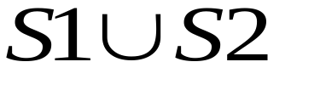
Union
S1
S2

Slide 11
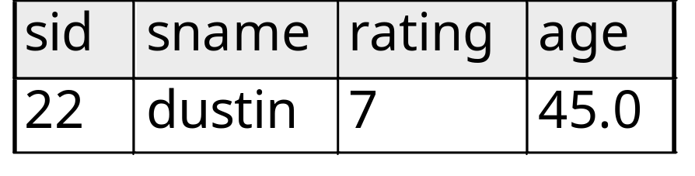

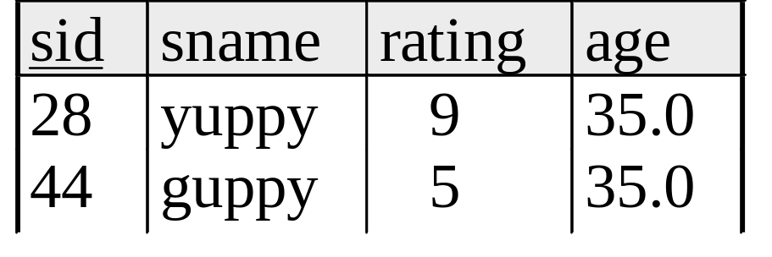
Set Difference
S1
S2 – S1
S2

Slide 12
Cross-Product
S1 × R1:
  Each row of S1 paired with each row of R1.
Q: How many rows in the result?
Result schema has one field per field of S1 and R1,
  Field names `inherited’ if possible.
  Naming conflict: S1 and R1 have a field with the same name.
  Can use the renaming operator:
Output relation name
Renaming list

Slide 13
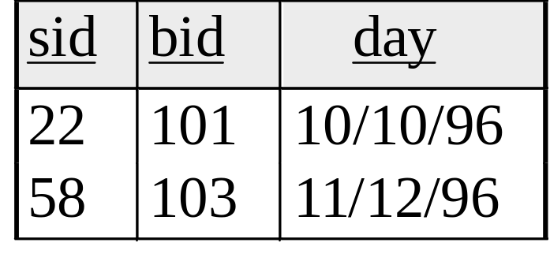
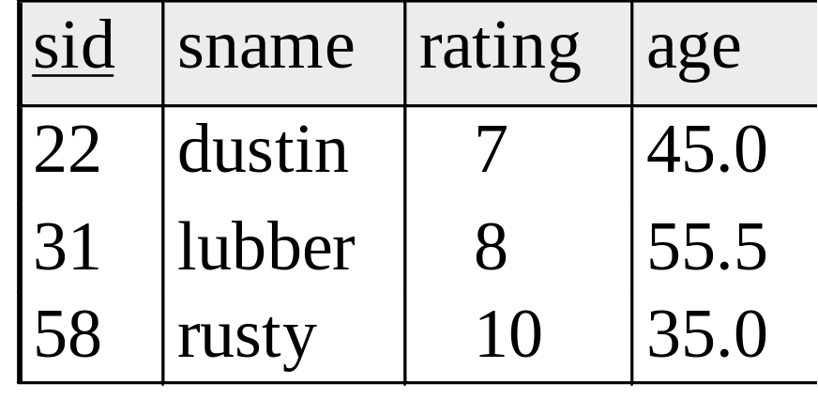
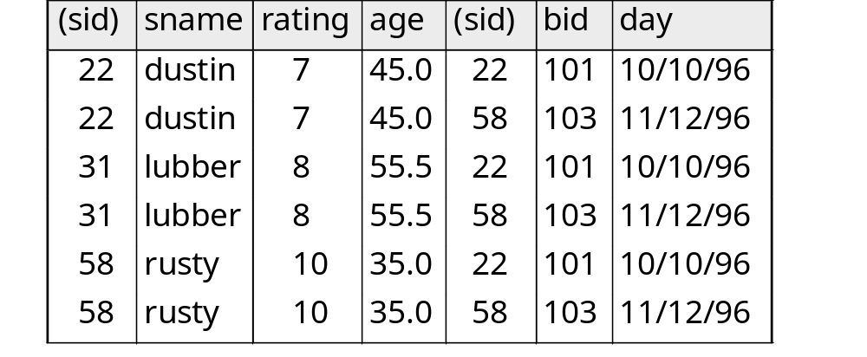
Cross Product Example
R1
S1
S1 x R1 =

Slide 14
Compound Operator: Intersection
On top of 5 basic operators, several additional “Compound Operators”
  These add no computational power to the language
  Useful shorthand
  Can be expressed solely with the basic operators.
Intersection takes two input relations, which must be union-compatible.
Q: How to express it using basic operators?
R ∩ S = R − (R − S)

Slide 15
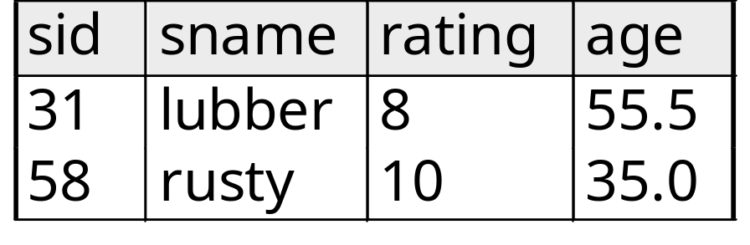

Intersection
S1
S2

Slide 16
Compound Operator: Join
Involve cross product, selection, and (sometimes) projection.
Most common type of join: “natural join”
  R S conceptually is:
    Compute R × S
    Select rows where attributes appearing in both relations have equal values
    Project all unique attributes and one copy of each of the common ones.
Note: Usually done much more efficiently than this.

Slide 17
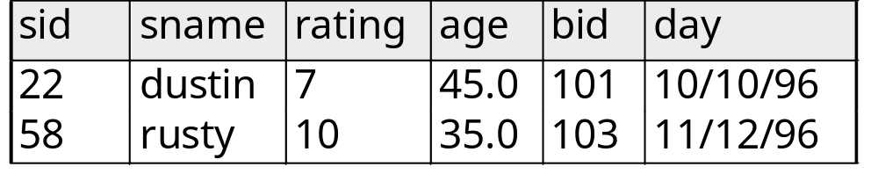
Natural Join Example
R1
S1
S1 R1 =

Slide 18

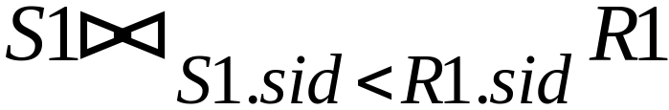
Other Types of Joins
Condition Join (or “theta-join”):
Result schema same as that of cross-product.
May have fewer tuples than cross-product.
Equi-Join: Special case: condition c contains only conjunction of equalities.
(
sid)
sname
rating
age
(
sid)
bid
day
22
dustin
7
45.0
58
103
11/12/96
31
lubber
8
55.5
58
103
11/12/96

Slide 19
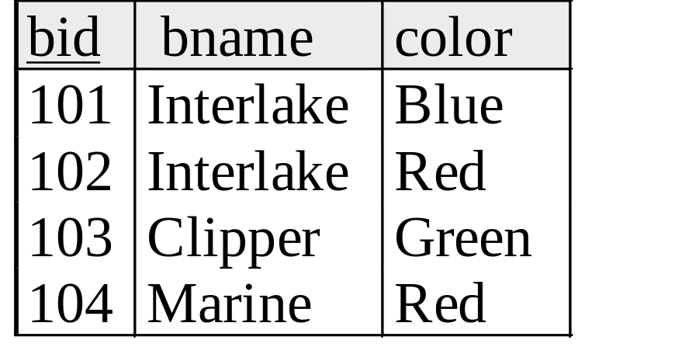
Examples
Reserves
Sailors
Boats

Slide 20
Find names of sailors who’ve reserved boat #103
Solution 1:
Solution 2:
A query optimizer can find the first solution is likely to be less expensive!

Slide 21
Find names of sailors who’ve reserved a red boat
Solution 1:
A more efficient solution:

Slide 22
Find sailors who’ve reserved a red or a green boat
Can identify all red or green boats, then find sailors who’ve reserved one of these boats:

Slide 23
Find sailors who’ve reserved a red and a green boat
Cut-and-paste previous slide?

Slide 24
Find sailors who’ve reserved a red and a green boat
Previous approach won’t work! Must identify sailors who’ve reserved red boats, sailors who’ve reserved green boats, then find the intersection (note that sid is a key for Sailors):

Slide 25
Summary
Relational Algebra: a small set of operators mapping relations to relations
  Operational, in the sense that you specify the explicit order of operations
  A closed set of operators! Can mix and match.
Basic ops include: σ, π, ×, ∪, —,
Important compound ops: ∩,

